Slide 1

Seeking Advantages of BBB Services:
Key Determinants of BBB Accreditation
Hazel Kim, Victor Ji, Tom Suo, Bao Truong, William Xu
Notes:
5 minutes

Slide 2
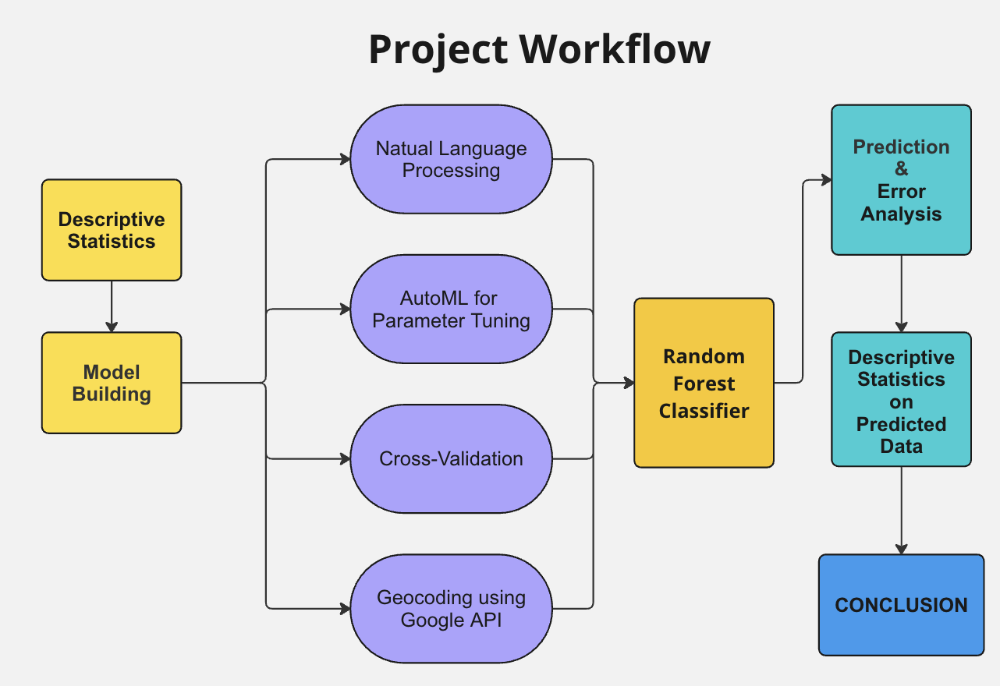
Project Workflow
Cleaned and augmented with geographic info.
Descriptive Statistics to understand data characteristics.
Developed Random Forest model for accreditation prediction.
Applied the model to non-accredited businesses to identify potential customers.
Performed descriptive statistics on potential customers to uncover commonalities.
Notes:
Google map API
→ Ran the descriptive statistics on the potential markets to find commonalities of them

Slide 3
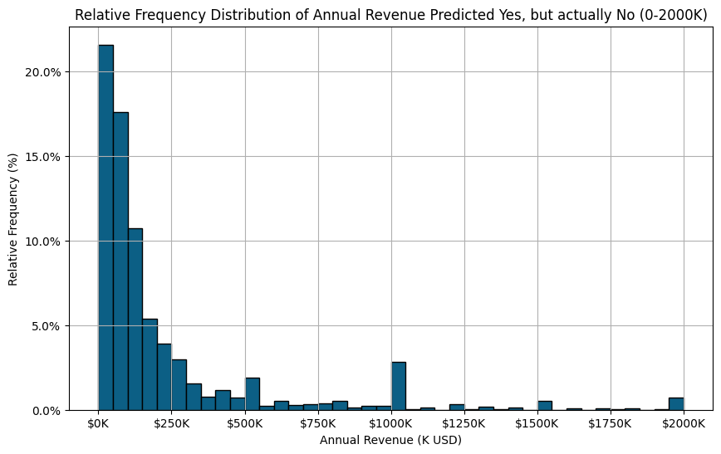
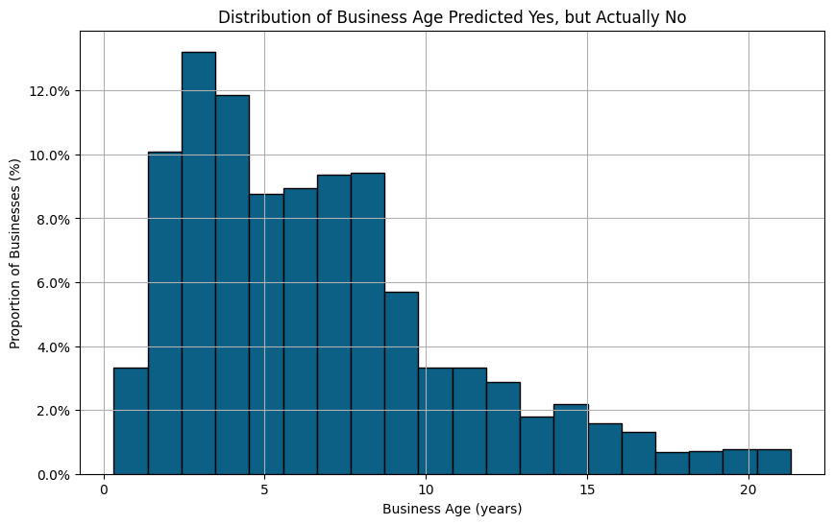
Prediction Model Specification 1
Distribution of Predicted Accredited Business Income
Distribution of Predicted Accredited Business Ages
Notes:
Older businesses have less accreditation and most happened during COVID.

Slide 4
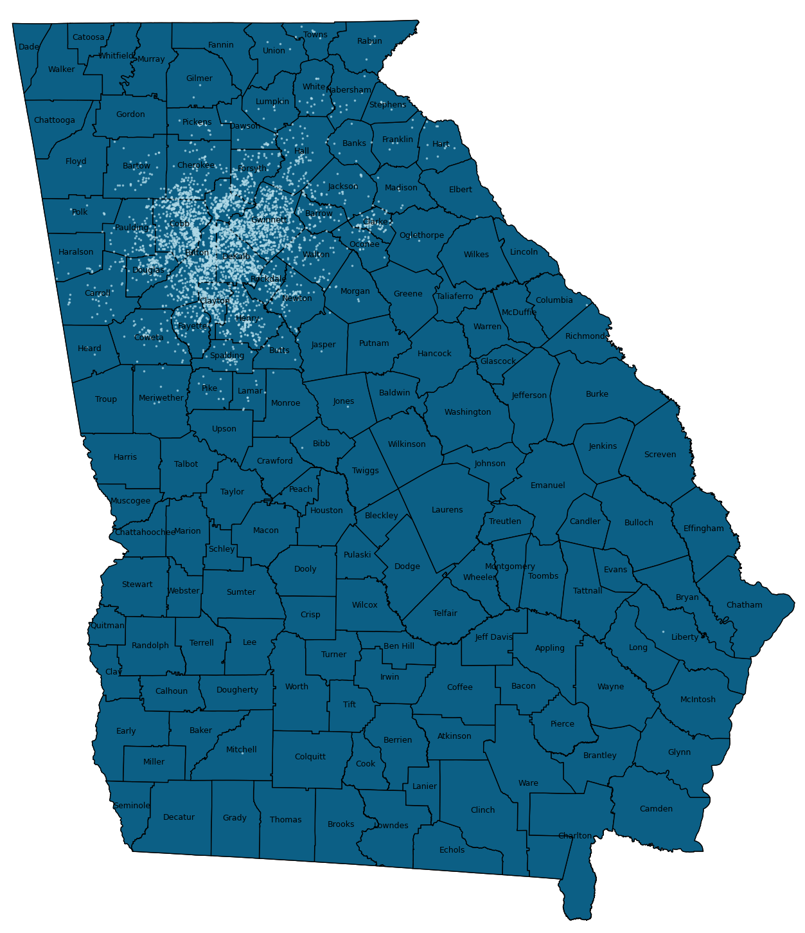
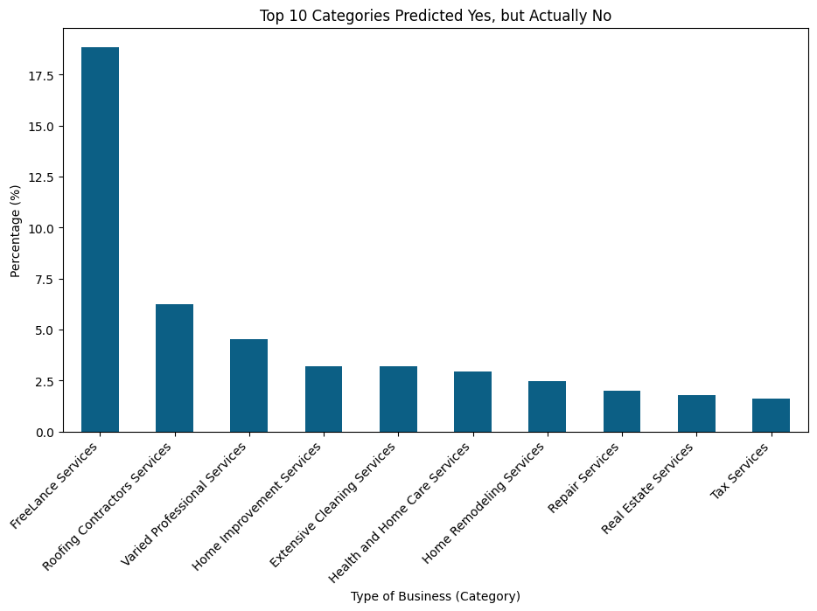
Prediction Model Specification 2
Predicted Location of Accreditation
Top 10 Categories Predicted to be Accredited by BBB

Slide 5
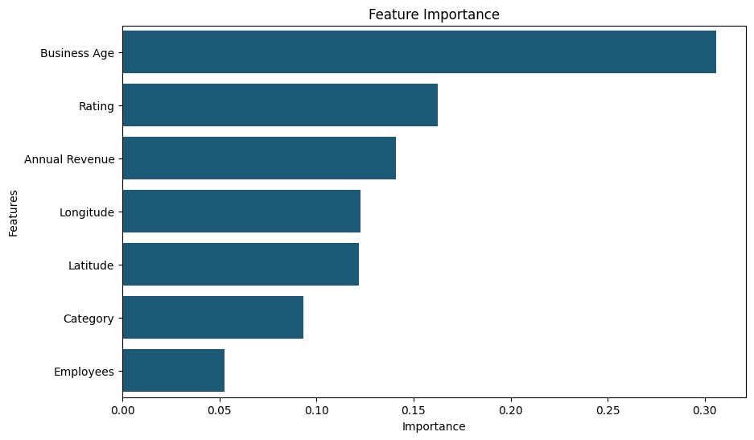
Strategies for BBB
Target qualified Freelance Services, Roofing Contractor Services, Home Improvement Services, Repair and Maintenance Services and so on to be accredited.
Target qualified business less 9 years of business age.
Focus on advertising to companies around Fulton County.
Target qualified companies with revenue of less than $250k.
Target qualified small business with around 3 3 employees.
Random Forest Predicted Determinants of Accreditation by BBB

Slide 6
Thank You!

